Slide 1
Pastiche Master: Exemplar-Based High-Resolution Portrait Style Transfer
poster in CVPR 2022
Shuai Yang
Liming Jiang
Ziwei Liu
Chen Change Loy
MM-Lab, Nanyang Technological University
presenter : 欣玉

Slide 2
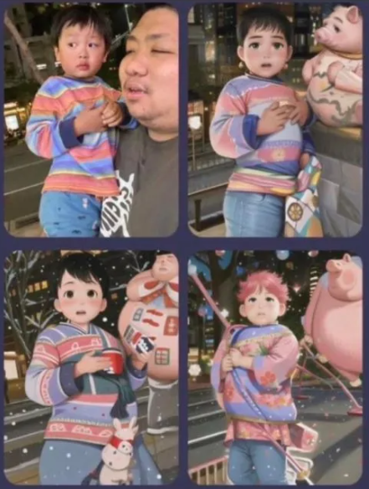
Outline
Introduction
Related Work
Method
Experiments
Conclusions

Slide 3
Outline
Introduction
Related Work
Method
Experiments
Conclusions

Slide 4

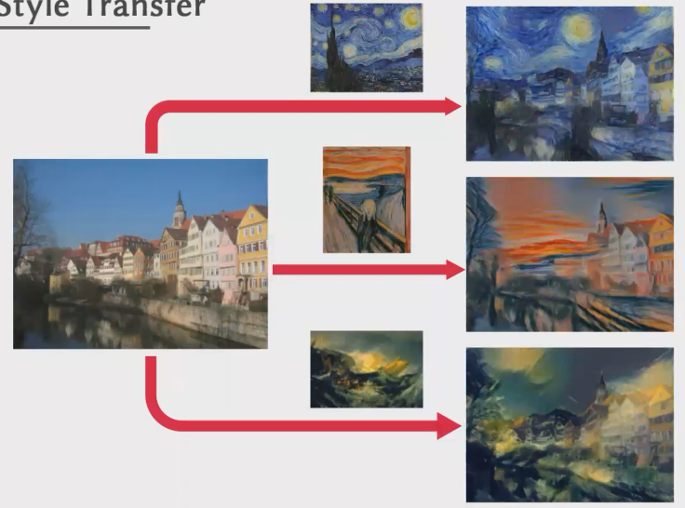
Exemplar-Based Image Style Transfer
Content Image
Structures
Style Image
Colors, textures
More Flexibility
CVPR 2016 Image Style Transfer Using Convolutional Neural Networks
Notes:
Exemplar-Based Image Style Transfer，我們會有一個content image負責掌管structures，還會有一個參考的style image example，model會把這style image的colors、texture轉移到content image上，那比起一般的Image Style Transfer，這種Exemplar-Based會更靈活更方便，因為user可以自己選擇想要的style image

Slide 5
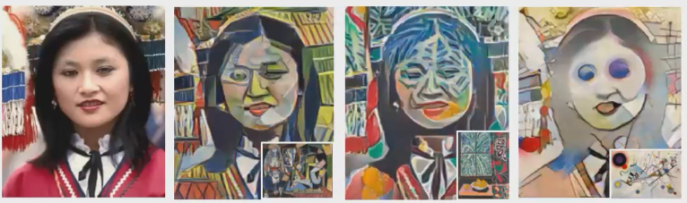
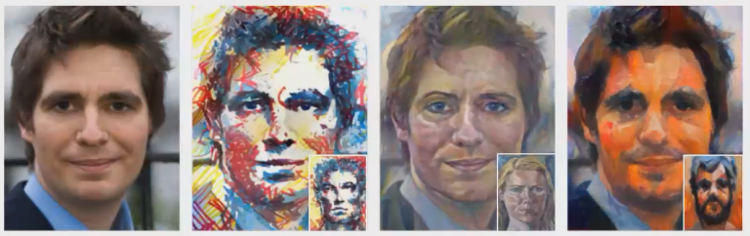
Exemplar-Based Face Style Transfer
Content Image
Face images
Style Image
Arbitrary paintings
Artistic portraits
CVPR 2019 Style Transfer by Relaxed Optimal Transport and Self-Similarity
SIGGRAPH 2016 Painting Style Transfer for Head Portraits using Convolutional Neural Networks
Notes:
那如果是要應用在人臉上，這邊有2個做得比較好的，第一個上面這個是用一些任意的painting當作style image，它確實有很好地把一些colors和textures貼上去，但是這個結果太抽象了，可能不是普遍人預期得到的結果，那下面這個是用portraits當作style image，這個結果就比較自然比較寫實一點，但這些結果還是只有轉移colors和textures

Slide 6
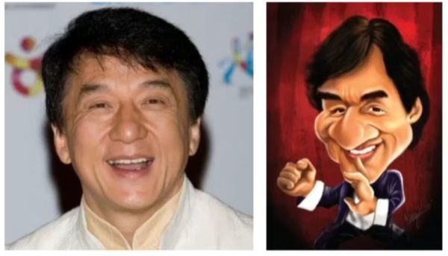
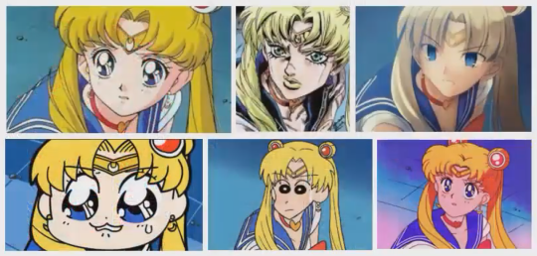
Exemplar-Based Face Style Transfer
Artistic portraits
Colors, textures
Simple patterns
Structures/shapes
Pastiche
Imitate the style of an artist or work
Notes:
要真正做到Face style transfer必須考慮整體的畫風，不只是color和texture，還有一些相關的形狀，結構也要去模仿，像上方這個成龍本人和成龍的諷刺畫風格，它會把鼻子誇飾化，下方這個女角色，她的眼睛會根據不同的漫畫作品畫風作變化

Slide 7
Outline
Introduction
Related Work
Method
Experiments
Conclusions

Slide 8
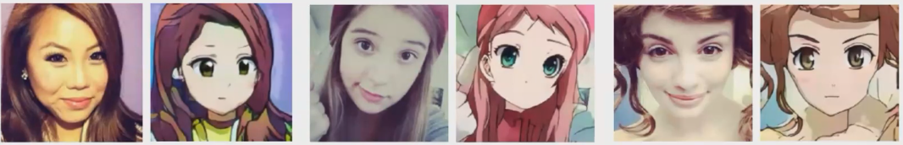
Image-to-image Translation
Learn a bi-directional mapping between the face and artistic portrait domains
Learn from scratch on complex bi-directional translations
Low-resolution images
Large dataset
Long training time
ICIR 2020 U-GAT-IT: Unsupervised Generative Attentional Networks with Adaptive Layer-Instance Normalization for Image-to-Image Translation
Notes:
舉例，有Image-to-image Translation這套方法，這套方法會讓model學習face domain和portrait domain之間的複雜的雙向關係，解析度低，需要較大資料集，也要train比較久

Slide 9
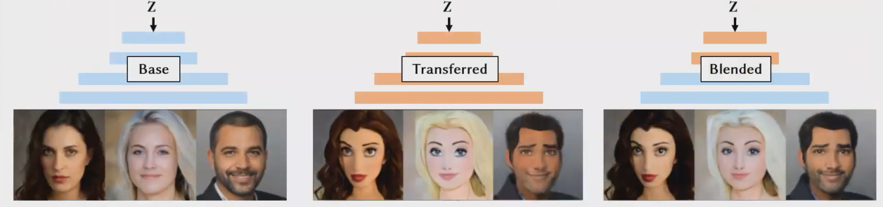
StyleGAN-based Toonify
StyleGAN generates realistic faces from random random noise z
Finetune styleGAN on cartoon dataset
Style blending → realistic colors, cartoon-like face shapes
pose
pose
gender
gender
texture
texture
color
color
NeurIPS 2020 Resolution Dependent GAN Interpolation for Controllable Image Synthesis Between Domains
Notes:
styleGAN輸入noise z，能夠產生多樣的真實的人臉，其中有很多layer，分別控制不同資訊，像是pose、gender、texture、color等等，我們把它finetune在一個cartoon dataset就可以變成一個卡通人臉生成器，接著我們可以做style blending，就是可能拿真實人臉的texture、color layer加上卡通人臉的pose gender layer，就能合成出我們想要的風格轉換結果

Slide 10
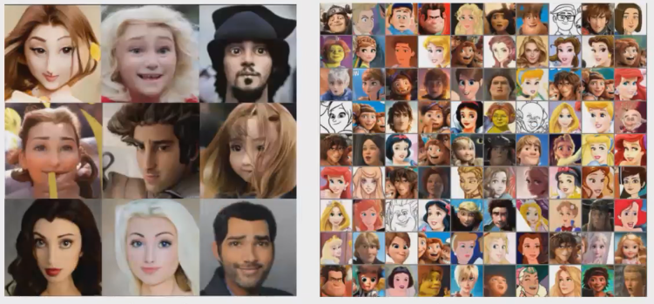
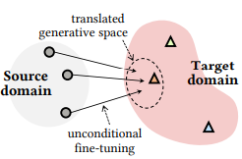
StyleGAN-based Toonify
Translates styleGAN generative space as a whole → loss of style diversity
Pros : small finetune dataset, fast training, high resolution, structure transfer
Cons : Not support exemplar-based style control
translated generative space
cartoon domain
Notes:
這套方法雖然能生成風格轉換的人臉，但它所產生的結果，比較貼近真實人臉的風格，比較單一沒那麼diverse，以左圖來解釋就是生成結果的空間相較於target domain來說小很多，它finetune完只能學到dataset的整體平均風格，而不能使用單一範例圖片當作轉換的參考

Slide 11
Outline
Introduction
Related Work
Method
Experiments
Conclusions

Slide 12
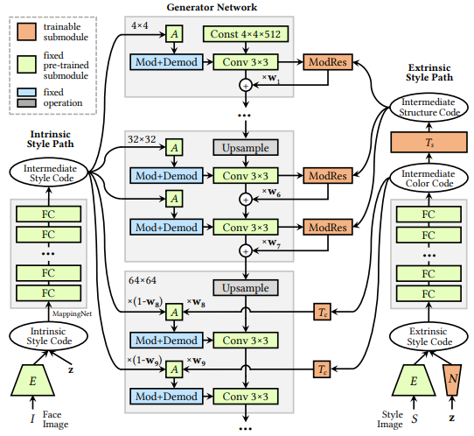
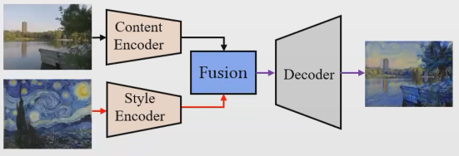
DualStyleGAN
Origin styleGAN
New added
Exemplar-based style transfer paradigm
Content → intrinsic style path
Style → extrinsic style path
Notes:
左邊這張圖顯示了Exemplar-based style transfer的大致流程圖，content encoder會取出content image feature，style encoder會取出style image feature，然後2個融合後送進decoder產生結果，那這個藍框對應到右邊的藍框，綠框對應到右邊的綠框，這2個框框合起來是原本的styleGAN，左邊的紅框對應到右邊的紅框，就是本文新增加的部分，然後作者把content這一路稱為intrinsic style path，style這一路稱為extrinsic path，也是命名為DualStyleGAN的原因

Slide 13
DualStyleGAN
Extrinsic style path
Intrinsic style path + generator
Fixed during training
Extrinsic style path
Adjust intrinsic style features
Structure + color
Mapping Net
→ 18 * 512 dimensional vectors
Notes:
左路這邊藍色綠色的原本的styleGAN的block都是fixed住的(可以避免mode collapse、比較好保留原本的content資訊)，目的是要讓右邊這一路所產生的structure code和color code影響左路的content features

Slide 14
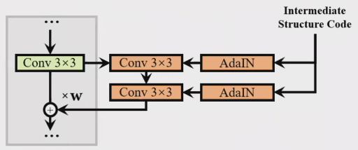
DualStyleGAN
Structure adjustment
Structure adjustment
First 7 layers : structure transfer
ModRes : Resblock + AdaIN
w : adjustment degree
ModRes

Slide 15
DualStyleGAN
Color adjustment
Last 11 layers : color transfer
w : adjustment degree
Color adjustment

Slide 16
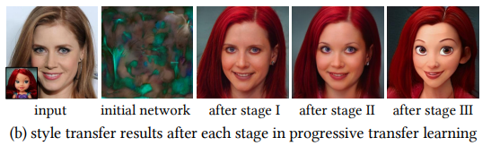
Progress fine-tuning scheme
Problem
Add new path → alter the generative space of the pre-trained styleGAN
→ cannot directly fine-tuning
Stage 1 : color transfer on source domain
Stage 2 : structure transfer on source domain
Stage 3 : style transfer on target domain

Slide 17
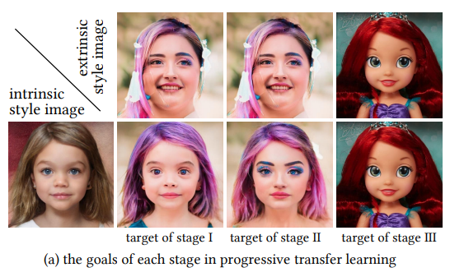
Progress fine-tuning scheme
Stage 1 : color transfer on source domain
Stage 2 : structure transfer on source domain
Stage 3 : style transfer on target domain

Slide 18
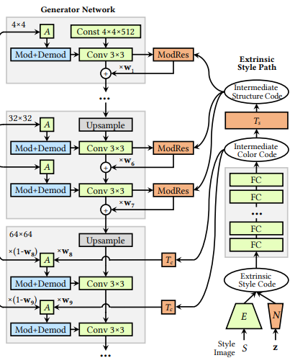
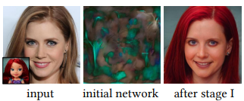
Progress fine-tuning scheme
Stage 1 : color transfer on source domain
Network initialization → ModRes close to 0
Tc = identity matrix

Slide 19
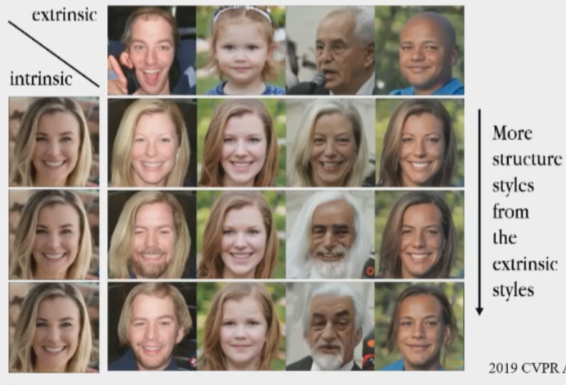
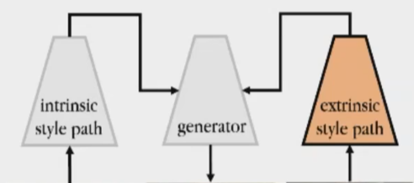
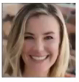
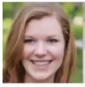
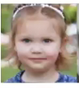

Progress fine-tuning scheme
Stage 2 : structure transfer on source domain
Use style blending in styleGAN to generate fused faces to train extrinsic style path

Slide 20
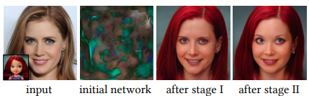
Progress fine-tuning scheme
Stage 2 : structure transfer on source domain
Use style blending in styleGAN to generate fused faces to train extrinsic style path

Slide 21
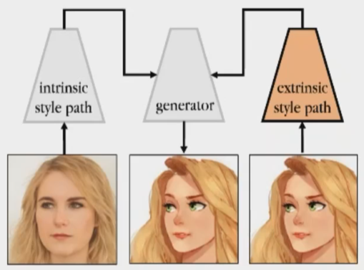
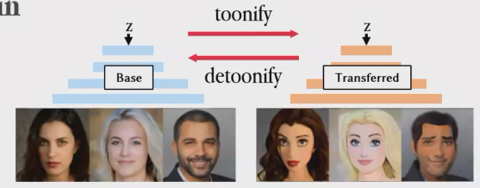

Progress fine-tuning scheme
Stage 3 : style transfer on target domain
Use destylization in styleGAN to generate paired training data
destylization

Slide 22
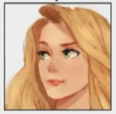
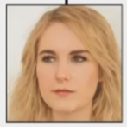
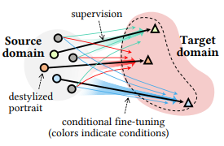
Progress fine-tuning scheme
Stage 3 : style transfer on target domain
Avoid mode collapse

Slide 23
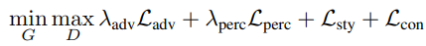
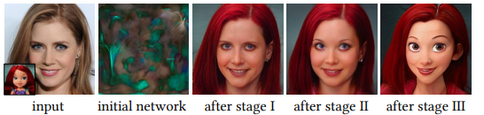
Progress fine-tuning scheme
Stage 3 : style transfer on target domain
Use destylization in styleGAN to generate paired training data
destylization

Slide 24
Outline
Introduction
Related Work
Method
Experiments
Conclusions

Slide 25
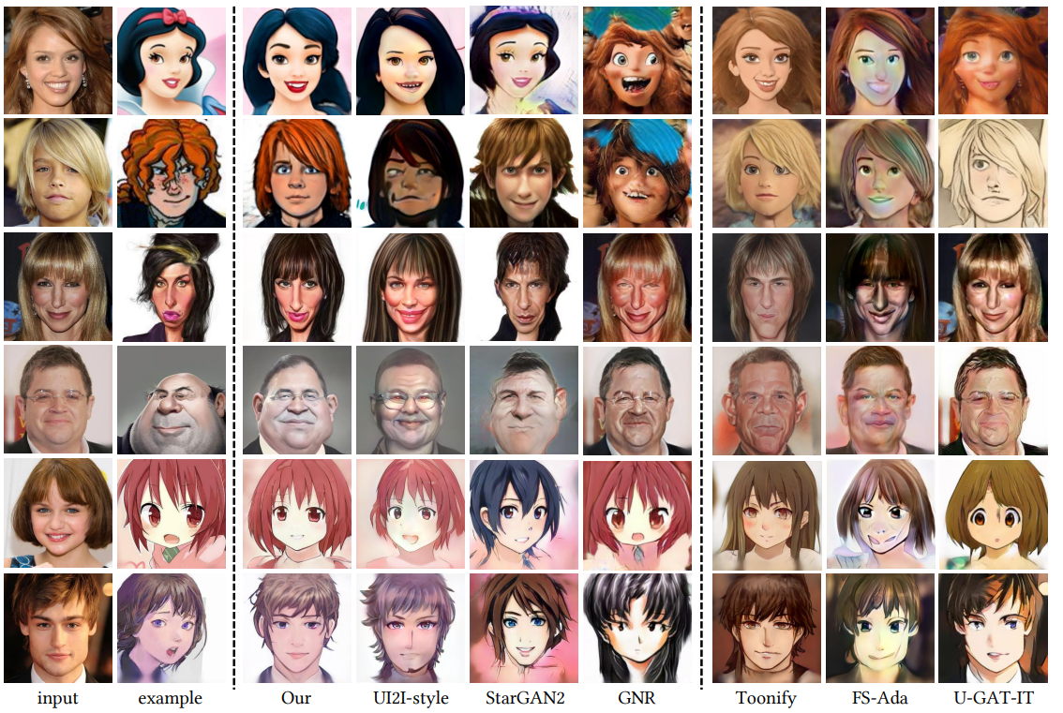
Visual comparison

Slide 26
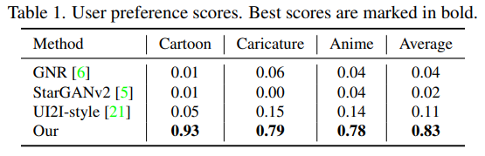
User study

Slide 27
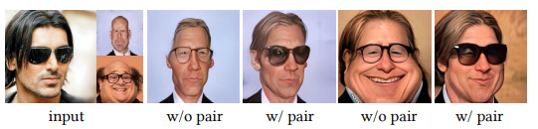
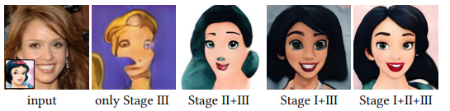
Ablation study

Slide 28
Outline
Introduction
Related Work
Method
Experiments
Conclusions

Slide 29
Conclusions
A novel DualStyleGAN
Characterize and control the intrinsic and extrinsic styles
Exemplar-based high-resolution portrait style transfer
Friendly data requirement
Well designed extrinsic style path
Hierarchical style manipulation
Both color and structures styles
A novel progressive fine-tuning scheme
Robustness

